Slide 1
CloudViz:
Cloud Powered Real Time Data Analytics and Visualization
Presented By
Mr. Abhinav Bhatt USN: 1BY15IS005
Mr. Dasari Ushodaya USN: 1BY15IS036
Under the guidance of
Dr.Swetha M S
Assistant Professor
Dept of ISE,BMSIT

Slide 2
Content
1. Abstract
2. Introduction
3. Existing System
4. Objectives
5. Problem Statement
6. Proposed System
7. Methodology
8. System Requirement Specifications
9. Applications of the Project
10. Conclusion
11. References

Slide 3
Abstract
The “CloudViz" project aims to develop a highly responsive and scalable dashboard leveraging advanced cloud computing technologies to visualize and analyze real-time data streams. This system will integrate data from a myriad of IoT devices and diverse APIs, processing it in real-time using cloud-based services, and presenting it through an intuitive, interactive interface. By harnessing the computational power and elasticity of cloud platforms, the project demonstrates significant advancements in handling dynamic data streams efficiently, thereby enhancing monitoring and decision-making processes across healthcare, finance, logistics, smart cities, and other sectors demanding immediate insights.

Slide 4
Introduction
In the modern data-driven world, the need for real-time data visualization has become essential across various industries. IoT devices generate continuous streams of data, and APIs provide dynamic data updates that necessitate immediate processing and visualization for actionable insights. This project utilizes the computational power and scalability of cloud computing to create a real-time data visualization dashboard, enabling users to monitor and analyze live data streams effectively. The dashboard is designed to be robust, scalable, and user-friendly, catering to the diverse needs of industries such as healthcare, finance, logistics, and smart cities.

Slide 5
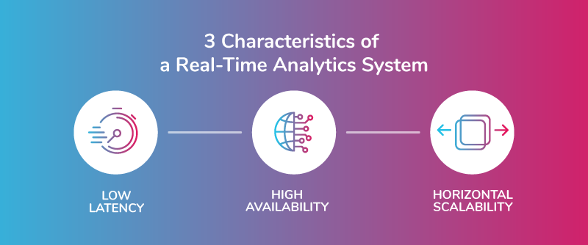

Slide 6
Existing System: Literature Survey
Current data visualization solutions often struggle to meet the demands of real-time data processing and visualization from diverse and dynamic sources such as IoT devices and APIs. Traditional systems typically rely on on-premises infrastructure and relational databases, which are ill-equipped to handle the scale and velocity of data generated by modern IoT ecosystems. These systems often encounter performance bottlenecks and scalability issues when tasked with processing and visualizing large volumes of real-time data.

Slide 7
Objectives
To develop a scalable dashboard using AWS that can effectively scale to handle large volumes of real-time data.
To implement robust data aggregation pipelines to inget and process real time data from various sources including IoT devices and APIs.
To optimize data processing pipelines and visualization components to ensure minimal latency and high throughput.
To enhance real-time data processing and analytics, the project will leverage serverless computing with AWS Lambda, Google Cloud Functions, or Azure Functions.
To demonstrate the scalability and efficiency of Hadoop MapReduce in real-world applications.

Slide 8
Problem Statement
There is an increasing demand for systems capable of visualizing real-time data from various sources to support instantaneous decision-making. Traditional data visualization systems are inadequate for real-time applications due to their inability to handle dynamic data streams efficiently, lack of scalability, and integration challenges. This project addresses these limitations by utilizing cloud computing to provide a robust solution for realtime data visualization

Slide 9
Proposed System
Utilize cloud-based IoT platforms like AWS IoT Core, Google Cloud IoT Core, and Azure IoT Hub for secure and scalable data ingestion from IoT devices, and integrate RESTful APIs for continuous data updates. Implement scalable, fault-tolerant data processing pipelines with Apache Kafka, AWS Kinesis, Google Cloud Dataflow, or Azure Stream Analytics, and leverage serverless computing technologies such as AWS Lambda, Google Cloud Functions, and Azure Functions for real-time analytics.

Slide 10
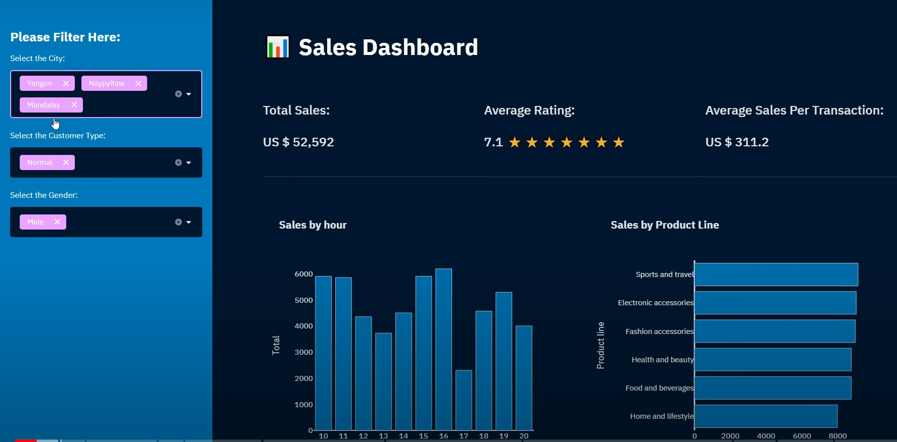

Slide 11
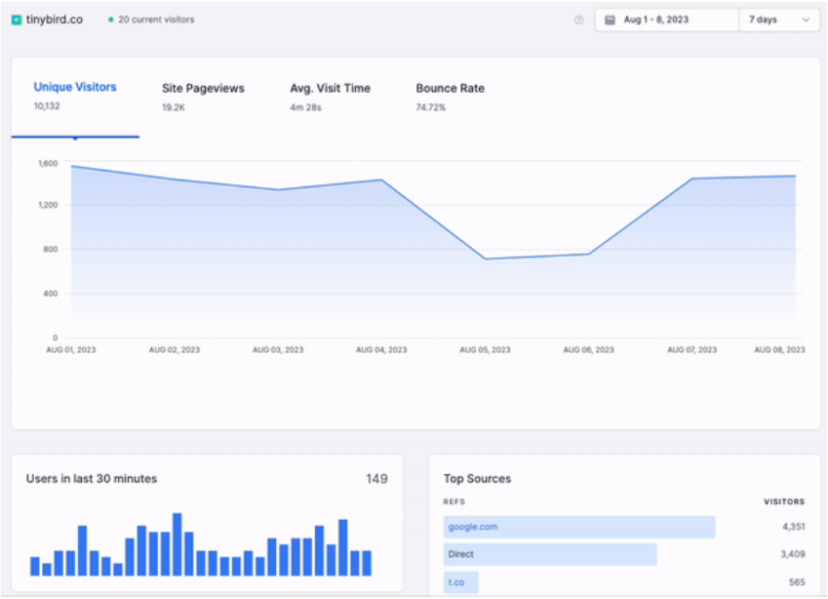
Real-time data visualizations show the most up-to-date data and refresh quickly.

Slide 12
Methodology
Data Collection and Ingestion: Set up AWS S3 for data storage with appropriate permissions, and implement scalable data ingestion pipelines using AWS Lambda or AWS Glue to handle large volumes of real-time data.
Real-Time Data Processing and Transformation: Utilize AWS Lambda for real-time processing and transformation of data, perform data enrichment and validation, and store processed data in AWS S3 or Amazon Redshift for analytical querying.Mapper-2 formats this output and orders it by keys.

Slide 13
3. Data Visualization with Power BI: Connect Power BI to AWS S3, design interactive real-time dashboards, and establish live data connections for dynamic updates and visualization of streaming data.
4. Deployment, Security, and Monitoring: Deploy and manage AWS resources, implement data security measures and compliance standards, monitor performance metrics using AWS CloudWatch and Power BI, conduct functional testing, and document system architecture and operational procedures for future reference and knowledge transfer.

Slide 14
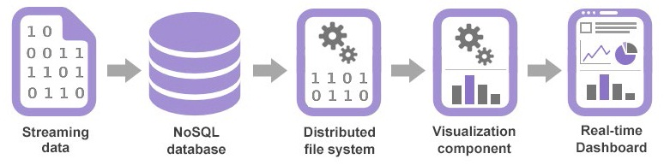
Real Time Data Analytics : high level overview

Slide 15
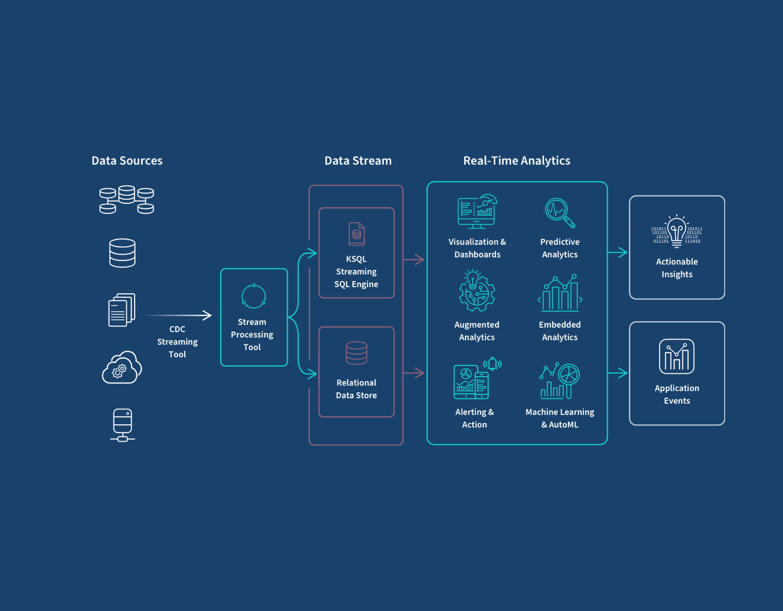

Slide 16
System Requirement Specifications
Hardware Requirements
Processor: Intel Core i5 or equivalent
RAM: 8GB minimum (16GB recommended)
Storage: 256GB SSD minimum
Network: High-speed internet connection
IoT devices (if applicable) for generating real-time data streams
AWS S3 Storage
Sufficient storage capacity to handle the anticipated volume of data
AWS Lambda and Other Services
Adequate compute capacity to process incoming data streams in real-time

Slide 17
Software Requirements
Operating System: macOS, Windows or Linux (Ubuntu, CentOS)
Hadoop Distribution: cloud Hadoop distribution with HDFS and MapReduce.
Programming Language: For data processing and scripting tasks .
Development Tools: Integrated development environment (IDE) or text editor for coding and debugging.
AWS: Access to AWS services such as S3, Lambda, Glue, CloudWatch, and IAM

Slide 18
Applications of the Project
Smart Cities
Utilize real-time data to enhance urban living through environmental monitoring, traffic management, and proactive infrastructure maintenance.
Healthcare
Continuously track patient vitals and manage hospital resources in real time for improved operations and timely medical interventions.
Finance
Analyze stock market data and financial indicators in real time to inform investment decisions and manage risks effectively.

Slide 19
Logisitcs
Optimize routes and improve customer communication with real-time shipment tracking, delivery status monitoring, and supply chain visualization.
Energy Management
Ensure stable energy supply and efficient grid integration through real-time monitoring of power grids, consumption patterns, and renewable energy generation.
Retail
Enhance marketing strategies and inventory management by visualizing sales data and customer behavior in real time.

Slide 20
Conclusion
The "Cloud-Enabled Real-Time Data Visualization Dashboard" project showcases the transformative potential of cloud computing in managing and visualizing real-time data. By integrating IoT devices and API data streams with tools like AWS S3, AWS Lambda, and Power BI, the system offers immediate, actionable insights, enhancing decision-making processes across various industries. This project highlights the importance of scalability, reliability, and user friendly interfaces in modern data solutions, ensuring the ability to handle large volumes of dynamic data while maintaining high performance and availability

Slide 21
References
[1] "IoT Fundamentals: Networking Technologies, Protocols, and Use Cases for the Internet of Things" by David Hanes, Gonzalo Salgueiro, Patrick Grossetete, Rob Barton, and Jerome Henry(2022).
[2] Sharma, S., & Singh, V. (2023). "Recent Advances in Cloud Computing: A Review." International Journal of Advanced Research in Computer Science, 14(2), 45-58.
[3] Li, Y., Wang, S., & Zhang, Y. (2023). "Real-Time Data Processing Framework for IoT Applications in Cloud Computing Environment." IEEE Internet of Things Journal, 10(5), 3725- 3735.

Slide 22


